Slide 1
‘Being loved into life’
St Peter’s Ruddington
Lent Course 2025

Slide 2
Here we are Lord!
We come from the busy-ness
of our daily lives
from the hubbub of our work and play
from the hue and cry of the world
around us,
we come to worship you.

Slide 3
In this hour, we long to meet you,
to feel your presence surrounding us,
enveloping us, loving us.
We long to settle with each other,
laying aside our worries and our cares,
aware of your presence around us,
before us, behind us, within us.
Come, Lord Jesus.
Amen.

Slide 4
Discussion questions:
Do you find prayer easy or hard
If someone asked you – how is your prayer life? What would you say?
How can you rate your prayer life – what criteria would you use.
Have any practices, rhythms or patterns been helpful in your prayer
What is your personal practice of prayer
Which person of the Trinity do you pray to? Why?
How do you recognise ‘successful’ prayer?
Who takes the initiative in your prayer – you or God?
What is the role of grace in your prayer life?

Slide 5
Session 1: Building a foundation.

Slide 6
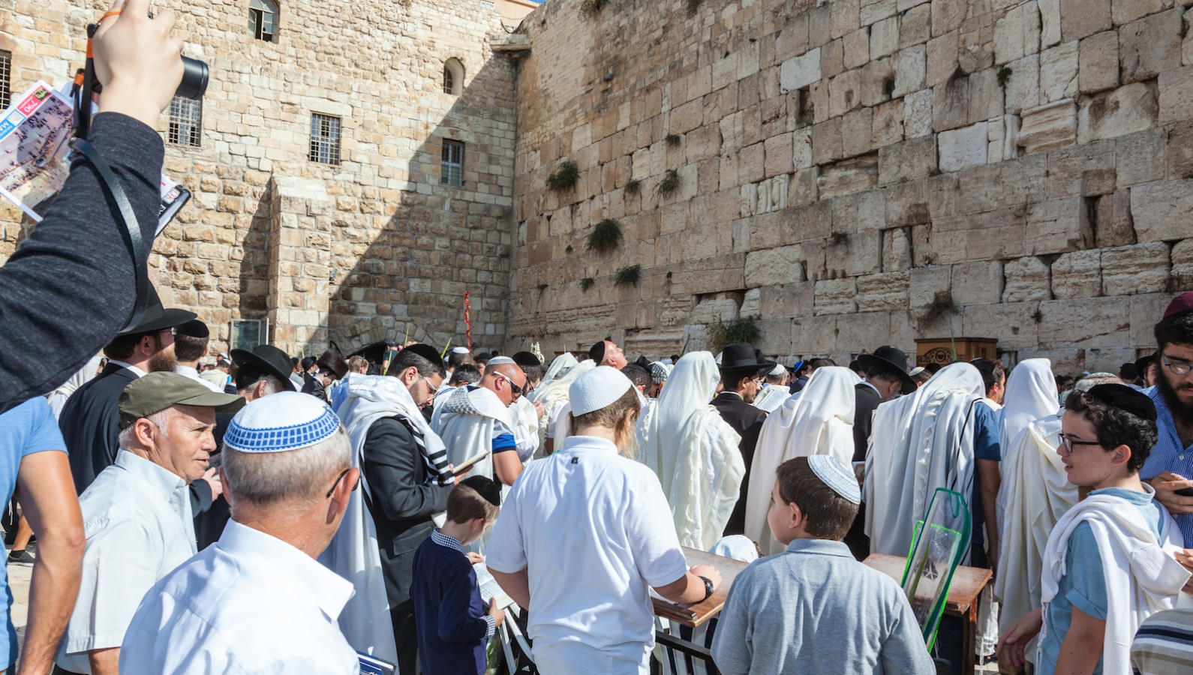

Slide 7
‘Didn’t you realise that you were God’s temple and that the Spirit of God was living among you? If anybody would destroy the temple of God, God will destroy him, because the temple of God is sacred; and you are that temple.’
1 Cor 3:16-17

Slide 8
“…but you will receive power when the Holy Spirit comes on you, and then you will be my witnesses not only in Jerusalem but throughout Judea and Samaria, and indeed to the ends of the earth.”
Acts 1:8

Slide 9
“And for anyone who is in Christ, there is a new creation; the old is gone, and now the new one is here.”
2 Cor 5:17

Slide 10
“Those who live according to the flesh have their minds set on what the flesh desires; but those who live in accordance with the Spirit have their minds set on what the Spirit desires. The mind governed by the flesh is death, but the mind governed by the Spirit is life and peace.”
Romans 8:5-6

Slide 11
Grace – as the power given us through the presence of the Holy Spirit.

Slide 12
Two models of Spirituality
Western model: ‘Self outside God’
Father Son
Holy Spirit
Human Spirit
Grace
Self initiates: God rewards
Body Mind

Slide 13
Two models of Spirituality:
Scriptural Model: Self-in-God
Father Son
Human Spirit
Grace
Holy Spirit
Body Mind
God initiates: Self responds

Slide 14
Self outside God:
- Person initiates God rewards.
Grace treasury of merit stored on heaven earned by good deeds
Focus reward for self now or in heaven afterwards
Emphasis on sporadically performed good deeds.
Self-in-God:
It is God who initiates and the person responds.
Grace is the transformation of the total person into the likeness of Christ by the freely given gift of the Holy Spirit.
Our focus is upon loving God and others, intimate relationship with God now.
Emphasis upon our internal attitudes and continual awareness of the Spirit’s movements.

